Slide 1
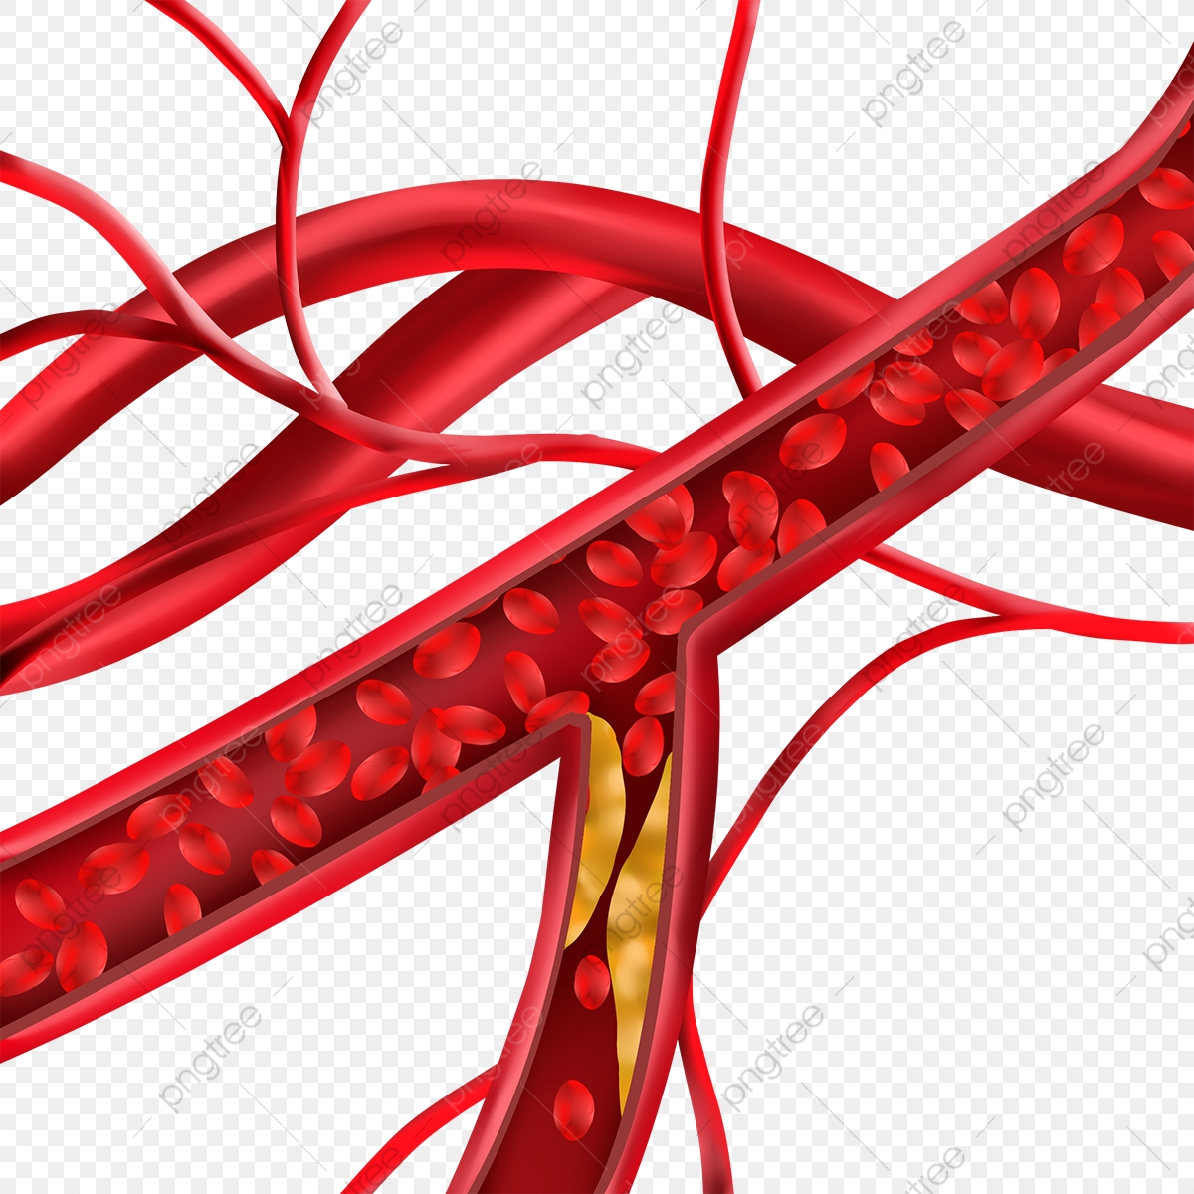
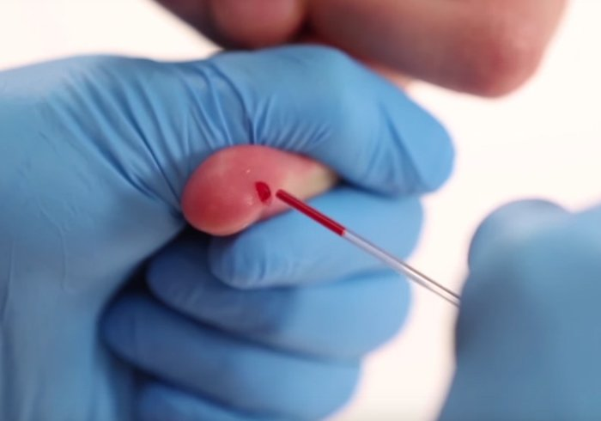
Capillaries and Veins
BY
PhD. Ansam Salih

Slide 2
Capillaries
Capillaries are blood vessels designed for the exchange of a variety of substances between blood and adjacent tissues, including nutrients, wastes and gases.
The design is simple in construction-a single layer of squamous-shaped endothelial cells and their basal lamina with a very small amount of adventitial material and occasional undifferentiated, stem like cells (pericytes).
The luminal diameters of capillaries are typically small, allowing the flow of blood cells to move through them in single file .The diameters are not identical throughout the body, varying from tissue to tissue. They mostly range from 5 to 10 µm, but change very little within a specific tissue.
As in arterial vessels, the lengths of capillary endothelia (usually 25 µm and longer) travel in the same direction as the vessel and are two to three times greater than their widths.
These cells can be extraordinarily thin. In the lung's alveoli, or air sac , the capillaries' endothelia can be less than 0. 2 µm thick, which is necessary for proper blood gas exchange

Slide 3
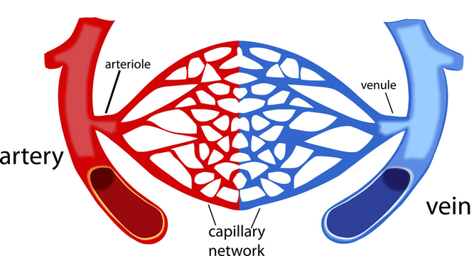

Slide 4
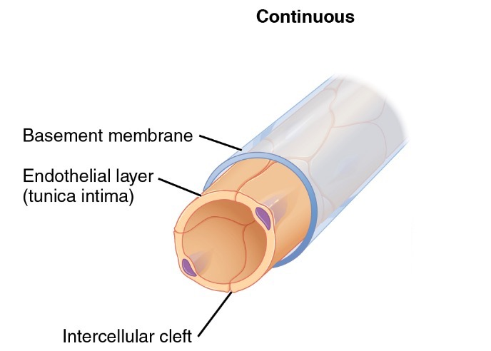
Continuous Capillaries
Continuous capillaries are blood vessels not interrupted by any physical space such as a pore. The endothelial cells associated with these vessels are interconnected along their lateral sides by cell junctions that include tight junctions (zonula occludens) , prevent any substances from circumventing this cellular lining. As a result any material that resides inside the lumen of this capillary must pass through the endothelium before entering the adjacent tissue .
In many continuous capillaries the exchange of materials is performed by acombinaion of endocytosis and exocytosis, a process known as transcytosis, and usually occurs from the luminal side toward adjacent tissue.
The continuous capillary is common throughout the body and especially prevalent in nervous tissue. The undifferentiated perivascular cell (pericyte) is often associated with the continuous capillary. Pericytes share the basement membrane of the endothelium, and are encapsulated by it. Cell processes of pericytes can come into contact with the endothelium, forming gap junctions with the latter

Slide 5
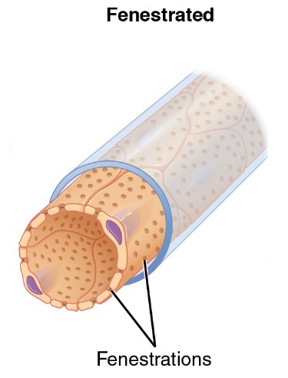
Fenestrated Capillaries
Fenestrated capillaries do not form a continuous cellular lining around the lumen, but instead possess numerous round fenestrae, approximately 60 to 80 nm in diameter, that are spanned by a diaphragm-like structure that is thinner than the thickness of the cell membrane .
The fenestrae are believed to facilitate the movement of molecular materials, which can be considerably large, into and out of the capillary lumen. Fenestrated capillary beds are associated with components of the endocrine system and the gastrointestinal tract. A form of the fenestrated capillary is the porous capillary in the kidney, specifically the region known as the renal glomerulus. In this instance, the pores lack diaphragms and much of the orderly arrangement that fenestrae often have.

Slide 6
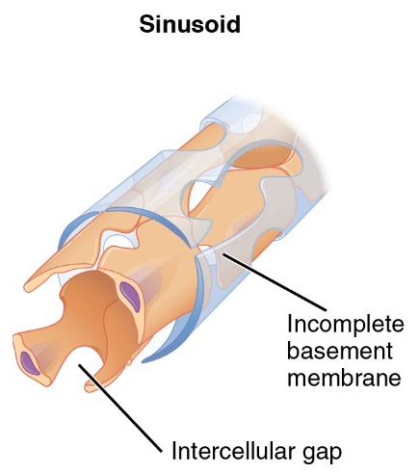
Sinusoid Capillaries
In certain regions in the body where blood becomes pooled and conforms to the shape that has been made available. Vessels within these regions are known as sinusoids or sinusoidal capillaries and occur within the liver, spleen, and other lymphoidal organs, bone marrow, and selected glands of the endocrine system. Sinusoids have often asymmetrical lumina and are porous, having variably sized diameters, some quite wide, and lacking the diaphragms that are characteristic of fenestrae. Blood flow varies greatly-from rapid in the choroidal sinusoids of the eye to slow to nearly non existent in the hematopoietic tissues.

Slide 7
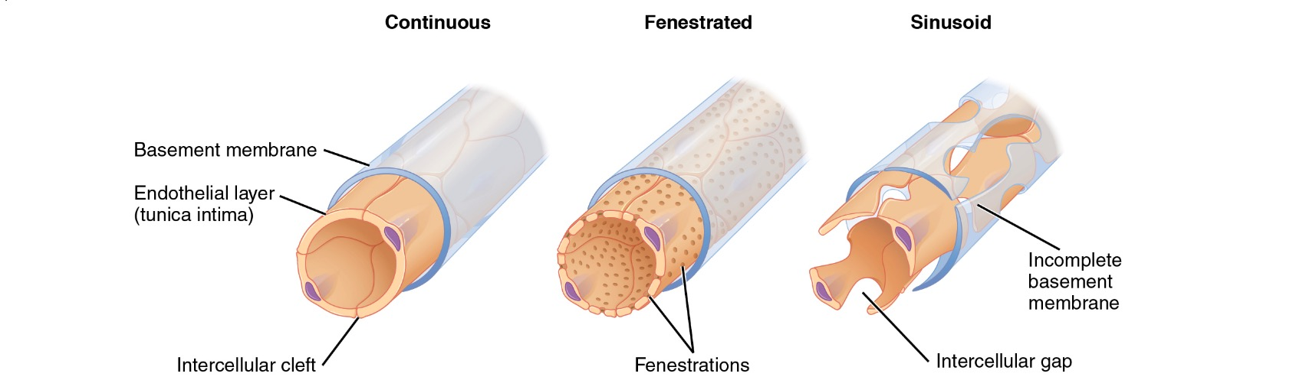
Types of Capillaries

Slide 8
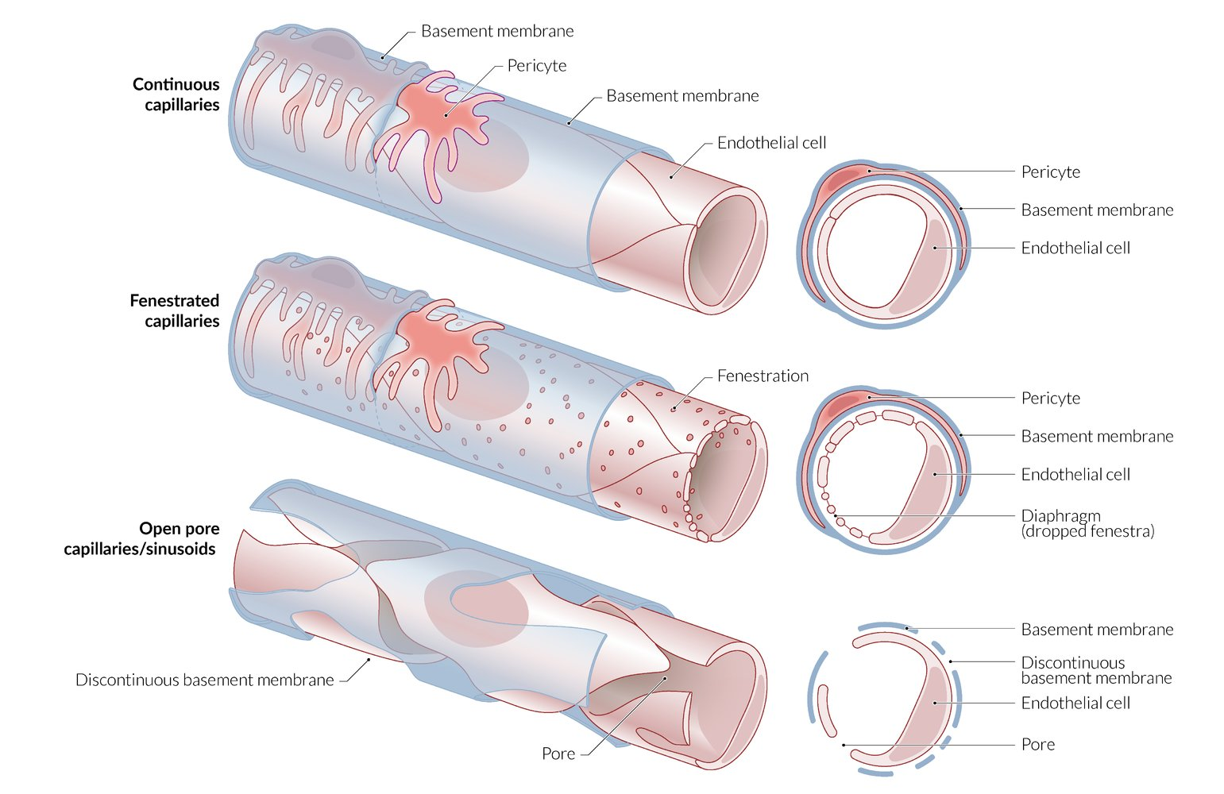

Slide 9
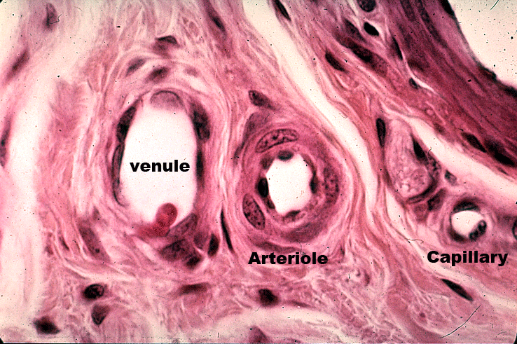

Slide 10
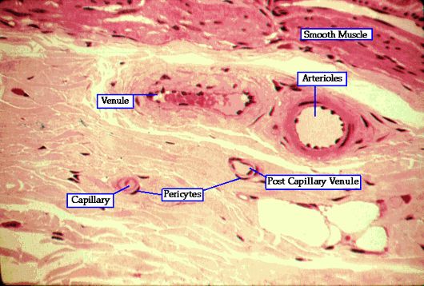

Slide 11
Veins

Slide 12
Veins
Unlike arteries, veins are characteried and categorized less on architectural construction and more on size. Consequently, they are traditionally described as small, medium, and large.
This is not to say that veins lack the tunics found in arteries, because the three tunics-tunica intima, tunica media and tunica adventitia-do exist, but they are not usually as defined as those in arteries.
In fact, the walls of veins are for the most part conspicuously thinner and less developed than those of the associated arteries within a specific portion of the body. However, because of the variety of mechanical conditions in different areas of the body that can influence venous structure, substantial variations of venous architecture can be found. For example, veins can possess valves-semilunar flap like extensions of the tunica intima. This is especially true for veins that lie within the limbs of the body

Slide 13
Types of Veins
The smallest veins are venules and correspond to arterioles with regard to both location and function .
Venules, empty into medium-sized veins, also known as collecting veins, and correspond functionally and by location to the muscular arteries.
Large veins direct blood back to the heart and from there to the lung. These veins, which include the jugular, renal, pulmonary and portal veins and vena cava, correspond to the aorta and its principal branches

Slide 14
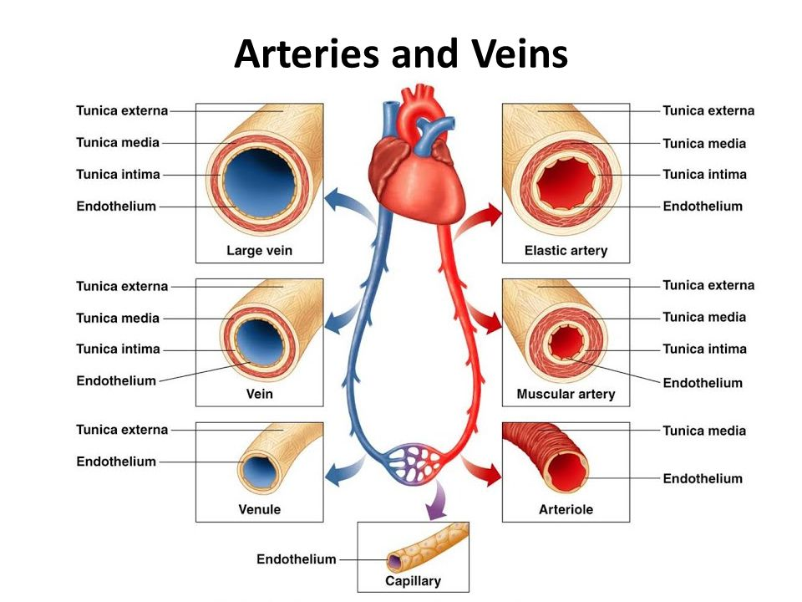

Slide 15
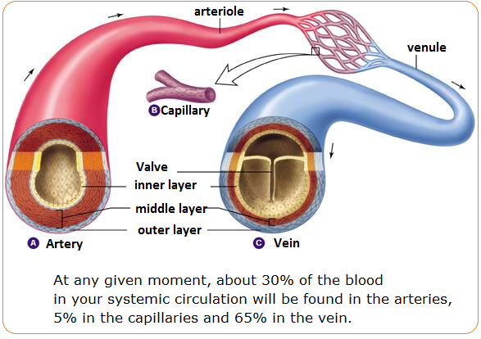

Slide 16
Small Vein
Veins that are immediately associated with and drain capillaries are post capillary venules and have the same construction as the adjoining capillaries, differing primarily in their luminal diameters, which range from 15 to 25 µm .
Typically the endothelium can be vasoactively stimulated (by histamine and other similar agents) and is surrounded by a layer of pericytes and a small amount of connective tissue (tunica adventitia or extema).
As the venules gradually increase in diameter, 30 µm and greater, they become enveloped by one or two incomplete layers of smooth muscle, constituting a tunica media, and an outer sheath of connective tissue, comprising the tunica extera.
The venules that arise from a continuous capillary bed are often more permeable in construction than the associated capillaries, especially regarding cell junctions, such as occluding and adhering junctions.
The small veins are largely similar to the muscular venules, having increased diameter widths and closely spaced smooth muscle, which at this point forms a continuous layer.

Slide 17
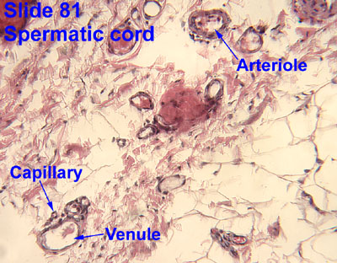
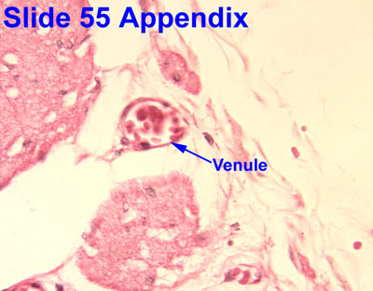

Slide 18
Medium Veins
As the small veins enlarge in diameter, they transform into medium veins with three well-developed tunics. Medium veins are typically less than 1 cm in diameter and drain most of the body into the large veins.
The tunica intima, here, contains a small amount of subendothelial connective tissue, including elastic fibers, that forms a thin network around the endothelium.
In many medium veins, extensions of the tunica intima form valves, projecting on an angle into the lumen as a pair of bi leaflets in the direction of blood flow.
In this way, blood flow is further facilitated as it is directed to the heart, while at the same time the potential for the backflow of blood is blocked.
The tunica media possesses smooth muscle loosely woven and circularly wound around the tunica intima.
The tunica externa of medium veins is usually well defined, and thicker than the tunica media. Its elements-collagen, elastic fiber meshwork, fibroblasts, and occasional small bundles of smooth muscle-are oriented along the longitudinal axis of each vein

Slide 19
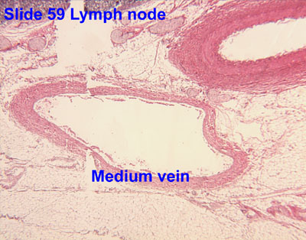

Slide 20
Large Veins
Large veins comprise the major veins of the body, which, as mentioned, are those that return blood back to the heart. Their construction differs from medium veins in several ways.
The tunica intima is more pronounced than that of medium veins, having a thicker subendothelial layer and an elastic fiber network .
The tunica media differs from that of medium veins even more by being generally much less developed.
In most instances, the tunica media is thin to nonexistent, having very little smooth muscle associated with it.
However, the tunica externa of large veins is similar to that of medium veins-comparably thick and with its components, including smooth muscle, oriented longitudinally or spirally

Slide 21
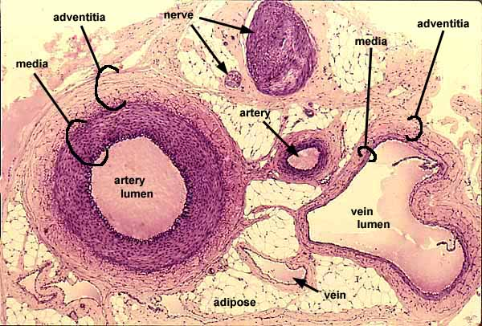

Slide 22
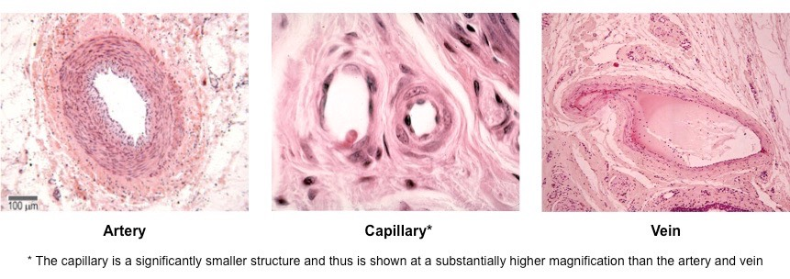

Slide 23


Thank you

